Slide 1
7.1 - Introduction to Project #1
Project Week

Slide 2
User story
Audience
General Population
Problem
Need to have quick access to latest outbreak information
Solution
Create app that used CDC & MAP API to quickly gather Corona Virus information

Slide 3
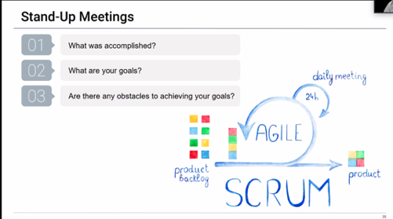
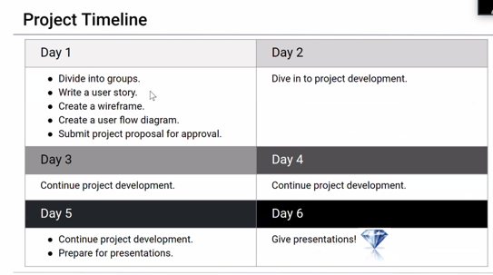
Daily scrum

Slide 4
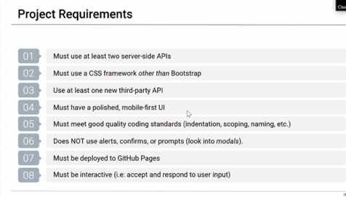
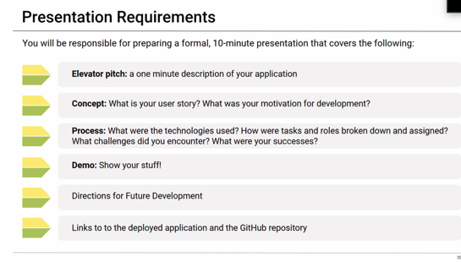
Project requirements

Slide 5
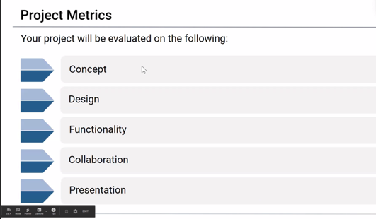
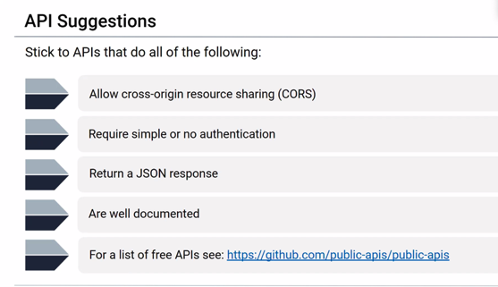
Project metrics

